Slide 1

Automation of Invoice Reporting with UiPath
Japheth Gordon
AI Automation | Project 6

Slide 2
Invoice Automation Workflow
Step 1: Read Invoices
Connect Google Drive folder → Document Understanding extracts: invoice number, supplier, due date, total amount from PDFs
Step 2: Confidence Check
If invoice number confidence < 0.7 → Log warning + skip invoice
Step 3: Filter Dates
Only process invoices due ≤ September 22, 2025
Step 4: AI Description
GenAI generates 15-word purchase summary (e.g., "Stage rental and catering services")
Step 5: Write to Sheets
Append valid invoices → 5 columns: number, supplier, date, amount, description
Step 6: Test Results
✅ 5 rows in Google Sheet✅ All columns populated✅ Low-confidence warnings logged⏱️ Saves 2-4 hours/week of work

Slide 3
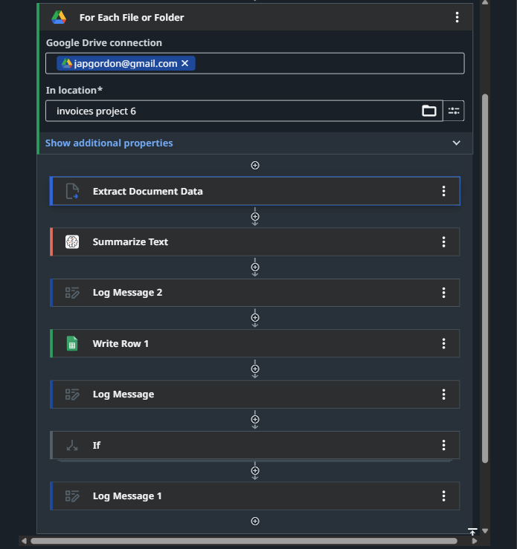
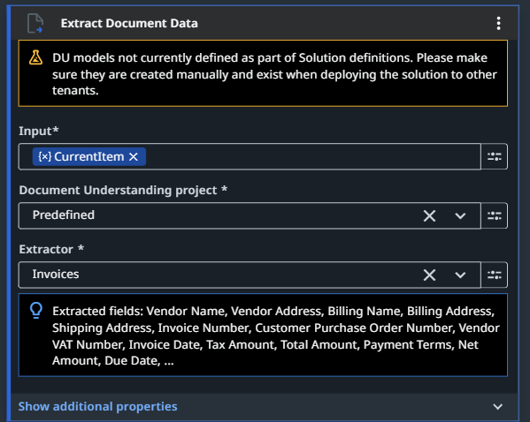
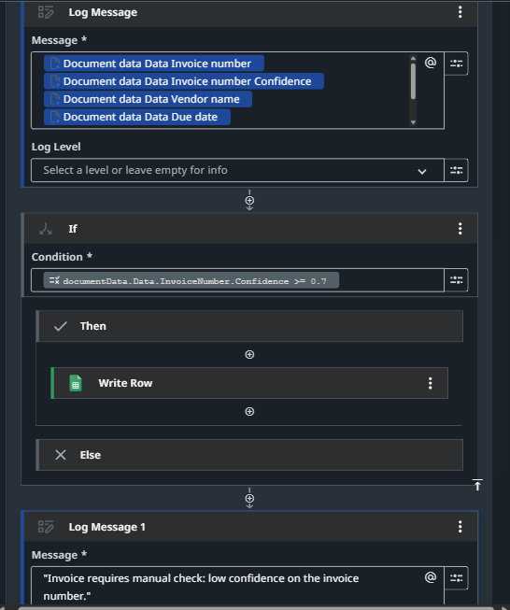
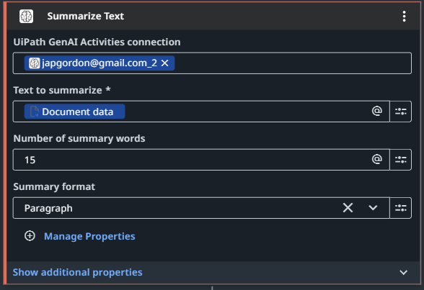
Invoice Automation workflow

Slide 4
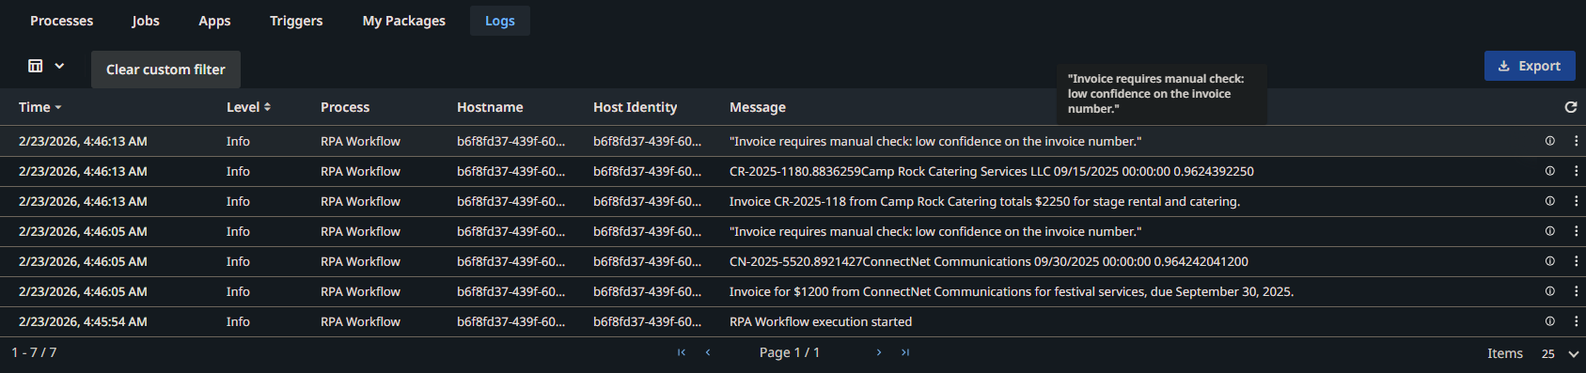
Low confidence messages
Confidence score measures UiPath's certainty in extracted invoice numbers (0-1 scale). 0.7 threshold flags low-confidence extractions for manual review. Prevents payment errors while auto-processing reliable invoices. Balances speed with accuracy for finance workflows.

Slide 5
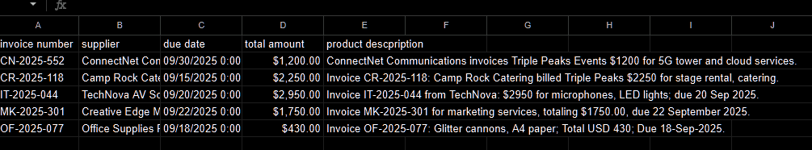
Google Sheets Auto Population
Google Sheets serves as the automated output destination, receiving 5 columns of invoice data from UiPath in real-time.
Finance managers instantly access due-date reports without manual entry, enabling quick filtering and cash flow tracking through cloud collaboration.

Slide 6
Saving Time: Finance Managers
This workflow eliminates 2-4 hours of weekly manual invoice processing per finance manager by automating PDF reading, data extraction, and description generation.
Managers gain instant visibility into due payments through a clean Google Sheet, reducing errors from manual copying and eliminating the need to open/review dozens of documents.
Low-confidence alerts maintain accuracy while freeing staff for strategic analysis rather than data entry, delivering faster insights for cash flow decisions.

